Slide 1
Lesson 3 – Logistic Regression and Vectorization

Slide 2
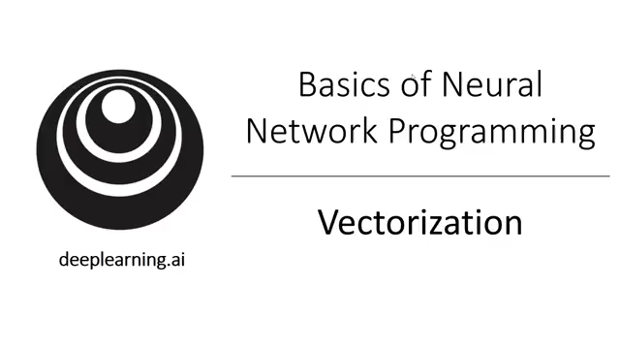
Vectorization

Slide 3
What is vectorization?

Slide 4
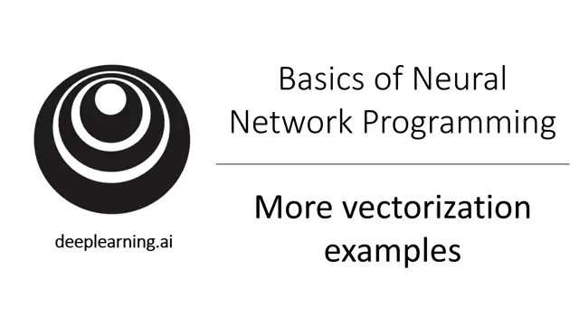
More Examples

Slide 5
Neural network programming guideline
Whenever possible, avoid explicit for-loops.

Slide 6
Neural network programming guideline
Whenever possible, avoid explicit for-loops.

Slide 7
Vectors and matrix valued functions
Say you need to apply the exponential operation on every element of a matrix/vector.
$$v= \left[\begin{matrix}v_{1} \\ ⋮ \\ v_{n}\end{matrix}\right]$$
u = np.zeros((n,1))
for i in range(n):
u[i]=math.exp(v[i])

Slide 8
Logistic regression derivatives
J = 0, dw1 = 0, dw2 = 0, db = 0
for i = 1 to n:
$z^{(i)}$ = $w^{T}x^{(i)}+b$
$a^{(i)}$ = $σ{(z}^{(i)})$
$J$+= $−\left[y^{(i)} \log{{\hat{y}}^{\left(i\right)}+({1−y}^{\left(i\right)})\log{(1 −{\hat{y}}^{\left(i\right)})}}\right]$
d$z^{(i)}$ = $a^{(i)}{(1−a}^{(i)})$
d${w_{1}}^{ }$+= $x_{1}^{(i)}\text{d}z^{(i)}$
d${w_{2}}^{ }$+= $x_{2}^{(i)}\text{d}z^{(i)}$
db += d$z^{(i)}$
J = J/m, d$w_{1}$ = d$w_{1}$/m, d$w_{2}$ = d$w_{2}$/m, db = db/m

Slide 9
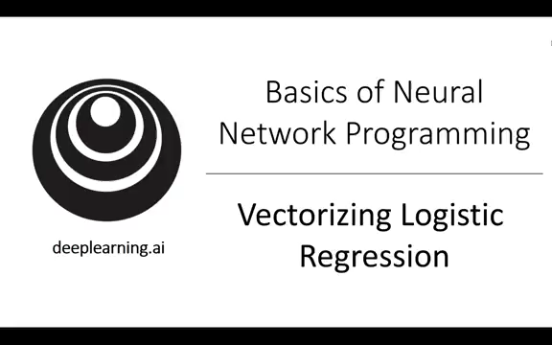
Vectorizing Logistic Regression

Slide 10
Vectorizing Logistic Regression
$$z^{(1)}=w^{T}x^{(1)}+b$$
$$z^{(2)}=w^{T}x^{(2)}+b$$
$$z^{(3)}=w^{T}x^{(3)}+b$$
$$a^{(1)}={σ(z}^{(1)})$$
$$a^{(2)}={σ(z}^{(2)})$$
$$a^{(3)}={σ(z}^{(3)})$$

